Slide 1
Examination System
BY : Abhishek Kumar Verma
Abhishek Pal
Anand Nishad

Slide 2
Contents:
Introduction
Objective
Home page
Scope
Portals used
Result

Slide 3
Introduction:
It is technological term in which exams are taking on computers instead of
traditional paper and pen based .
It will considerably replace the traditional paper and pen based exam in future.
These type of examinations are conducted through the internet or interanet .
It can be conducted either offline or online.
It is a modern method of taking test, candidate is given limited time to answer questions and after time expiry answer sheet will auto submitted.
Examiner will evaluate answers using automated process .

Slide 4

Examination System

Slide 5
Objective:
Create a web application to be used in place of old paper based user examination process.
Easy to use for Administrators , Faculties and Students.
Education maintain records , score cards, student details, question papers, and so on is very easily managed by the system.
Examination can be conducted at any time.

Slide 6
Scope:
Examination System is designed for Educational Institutes like schools, colleges and private institutes to conduct logic tests.
Can be used anywhere any time as it is web based application .
No restriction that examiner has to be present when the candidate take the test.
Easy to conduct surprise tests and generate quick results.

Slide 7
Portals Used:
Admin
Teacher
Student

Slide 8
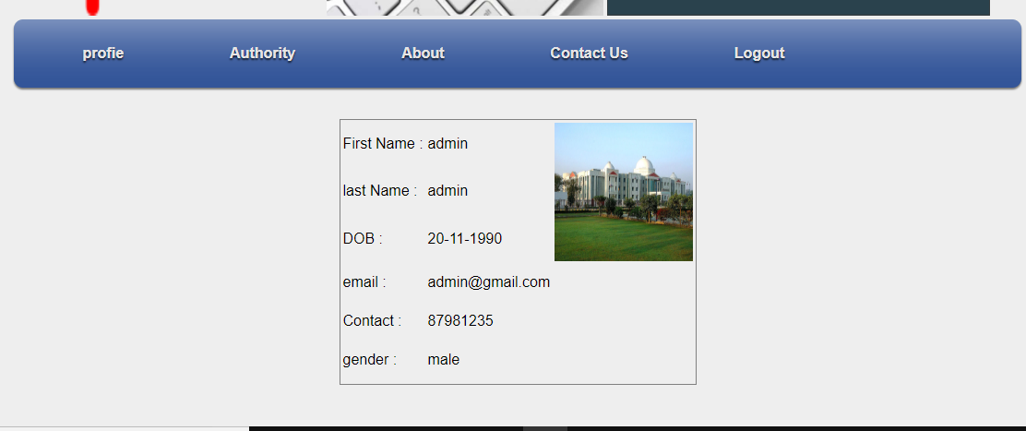
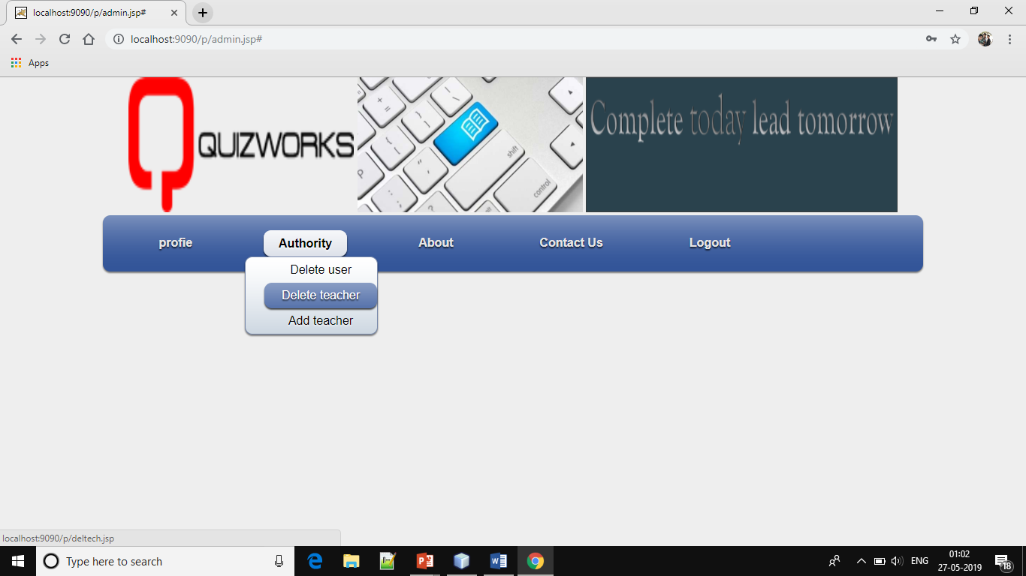
Admin
Admin login using userid and password and it will
to admin functionality.
Admin can create teacher accounts , user account
backup database from here.
Admin can delete teacher, delete user can add teacher.

Slide 9
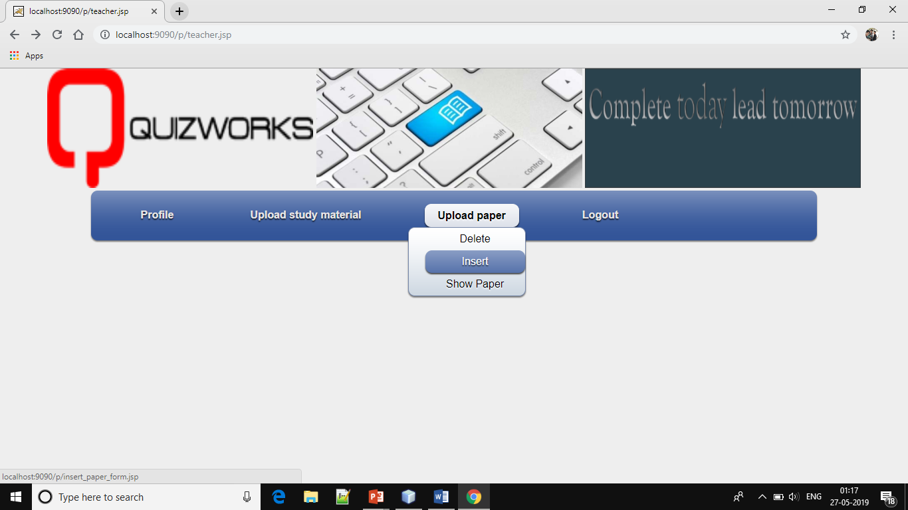
Teacher
Logging into the system by user id and password.
Teacher has the authority to upload a question
paper.
Teacher can inert new question paper and can
delete the old question paper.
Marking correct answer with the given option.

Slide 10
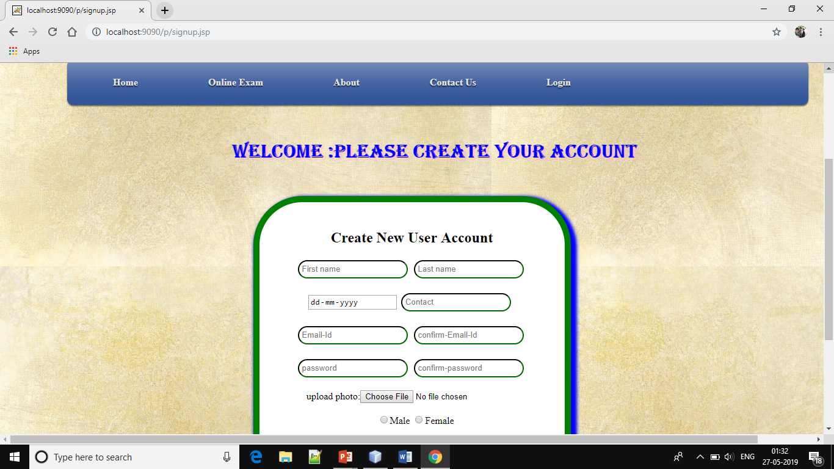
Student
Get Registered .
Logging in to the system.
Can take test.
Also can se his/her result.

Slide 11
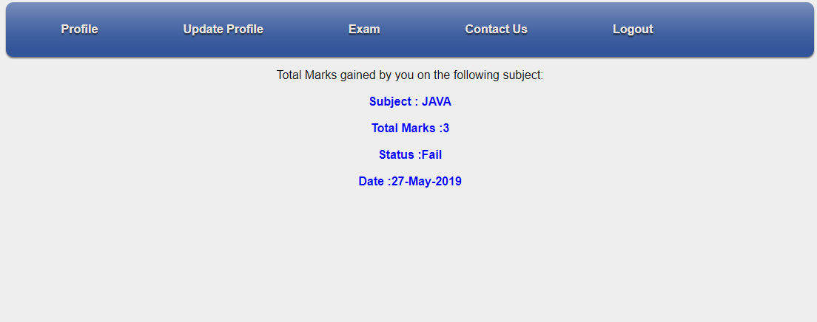
Result

